Slide 1
ADMISSION PREDICTION using ml
P. Ruchitha
19311A12J5
IT-D

Slide 2
CONTENTS
ABSTRACT
INTRODUCTION
DATA DESCRIPTION
SOFTWARE LIBRARIES USED AND METHODOLOGY
DATA ANALYSIS
MODELING METHODS
IMPLEMENTATION
RESULT
CONCLUSION

Slide 3
ABSTRACT
In response to the highly competitive job market at present times, an increased interest in graduate studies has arisen. This has not only burdened applicants but also led to an increased workload on admission faculty members of universities. Any chance of abridging the admission process impelled applicants and faculty workers to look for faster, efficient, and more accurate methods for predicting admissions. The goal is to implement and compare several supervised predictive analysis methods on a labeled dataset based on real applications from the prestigious universities. Regression, classification, and Ensemble methods are all the supervised methods that are to be employed for prediction. The dataset relies profoundly on the academic performance of the applicants during their undergrad years. The coefficient of determination, as well as precision and accuracy, are the measures used to compare the different models. All predictive methods proved to show accurate results, however certain methods proved to be more promising than others were. Predictions were obtained within short time frames, which in turn will cut down the time in the admission process.

Slide 4
INTRODUCTION
I will give brief introduction about the main algorithm used in my project, it includes selecting base model and other models fitting. Machine learning mainly solves classification and regression problems, which is an important research area and very useful in making decision. Both of classification and regression algorithms aim to evaluate unknow data by training labeled data sample. But they are still different. The output of the former is discrete, which means we separate data to a few classes by classification algorithm then evaluate new coming data belongs to which class. The output of the latter is continuous, which means we learn from old data then evaluate the probability of an event happening. Prediction of USA graduate admission for Indian undergraduate appliers” based on regression algorithms. The main content is to show the process from analyzing data, making model to result evaluation. In section we will explain my dataset and introduce the research background, and the methods of data preprocessing, cross validation and best parameter search will also be mentioned.

Slide 5
Data description
The dataset contains information about a student's:
GRE Score
TOEFL Score
University Ratings
Statement of Purpose Score
Letter of Recommendation Score
CGPA
Whether the Student Has Done Any Research
Chance of Admission (What We're Trying to Predict)
Label Count Mean Std Max Min
GRE | 500 | 316.4 | 11.29 | 340 | 290
TOEFL | 500 | 107.2 | 6.08 | 120 | 92.0
Uni Rating | 500 | 3.11 | 1.14 | 5.0 | 1.0
SOP | 500 | 3.37 | 0.99 | 5.0 | 1.0
LOR | 500 | 3.48 | 0.92 | 5.0 | 1.0
CGPA | 500 | 8.57 | 0.60 | 9.0 | 6.8
Research | 500 | 0.56 | 0.50 | 1.0 | 0.0
Chance of admit | 500 | 0.72 | 0.14 | 0.97 | 0.34

Slide 6
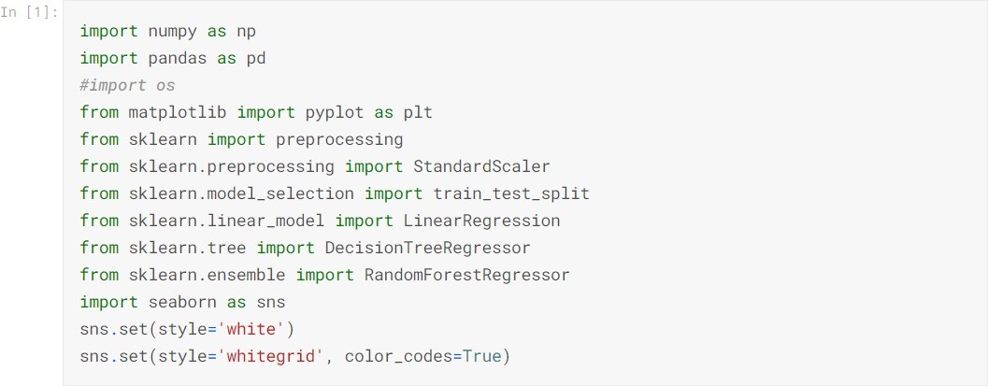
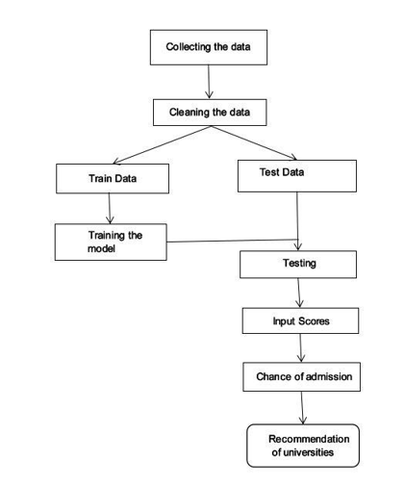
SOFTWARE LIBRARIES USED AND METHODOLOGY

Slide 7
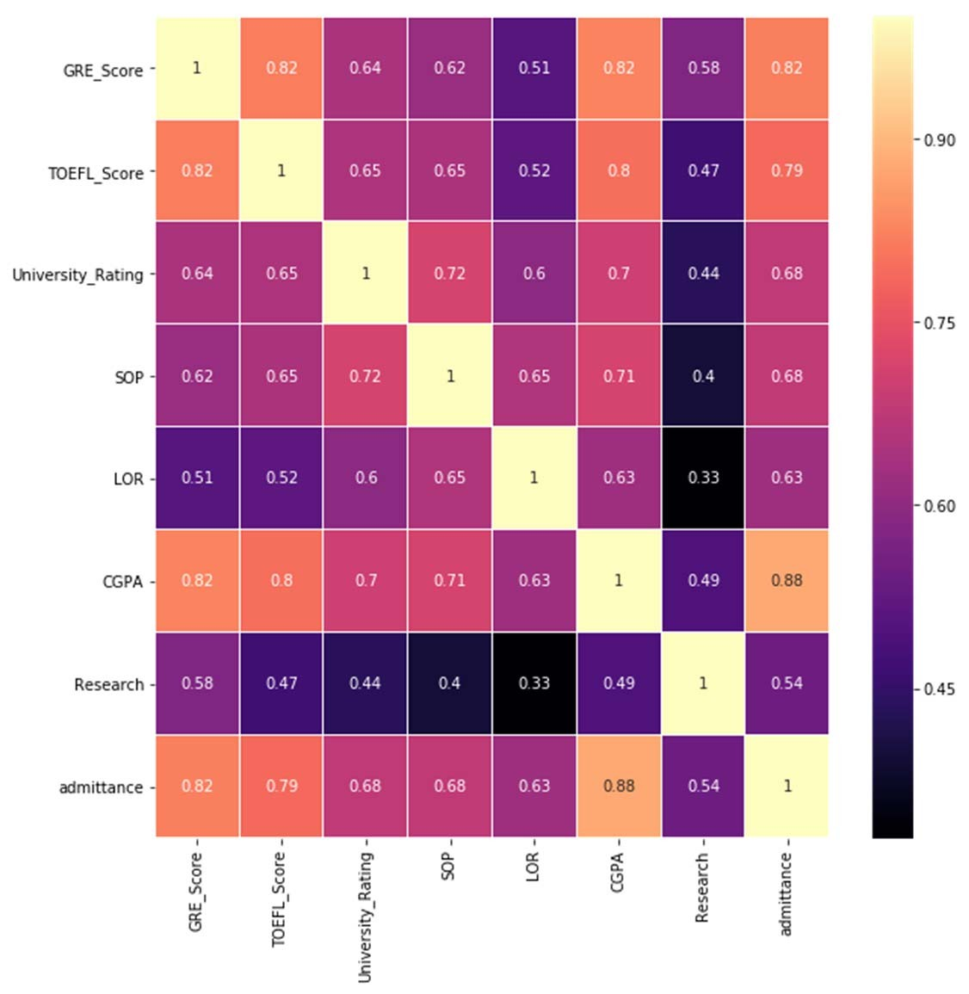
DATA ANALYSIS
As seen above the data scales differ profoundly across attributes and this can affect the Algorithm in fitting the data with the “widest fitting street”. To avoid this effect a preprocessing technique known as Standard Scaling is imported from Scikit- learn; this technique was chosen over min-max scaling given that the data might include several outliers.
Correlation matrices help provide an intuitive idea about what predictive analysis methods would be more useful in finding a suitable model. It employs Matplotlib and Seaborn libraries to plot the correlation matrix using color maps to help emphasize the number scale in colors
“GRE_Score” along with “TOEFL_Score” have a high correlation among each other along with the “CGPA”

Slide 8
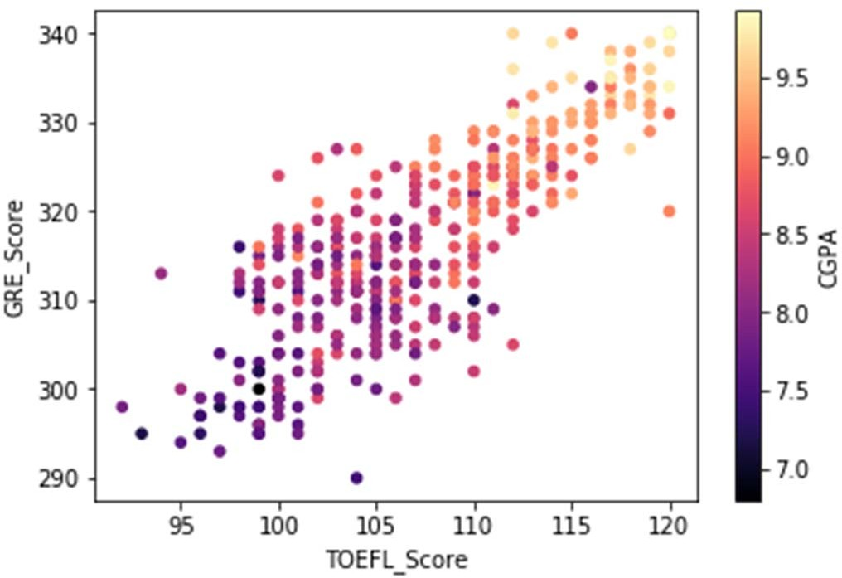
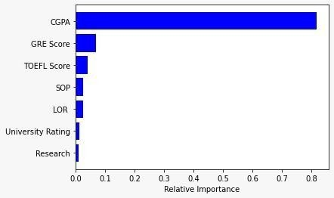
.
Correlation between the GRE_Score, CGPA, and TOEFL_Score:

Slide 9
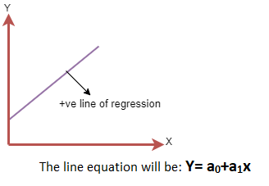
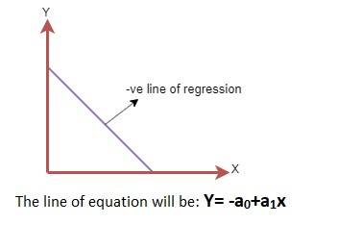
Modeling methods
LINEAR REGRESSION:
Linear regression is one of the easiest and most popular Machine Learning algorithms. It is a statistical method that is used for predictive analysis. Linear regression makes predictions for continuous/real or numeric variables such as sales, salary, age, product price, etc.
Linear regression algorithm shows a linear relationship between a dependent (y) and one or more independent (y) variables, hence called as linear regression. Since linear regression shows the linear relationship, which means it finds how the value of the dependent variable is changing according to the value of the independent variable.
Mathematically, we can represent a linear regression as:
y= a₀+a₁x+ ε

Slide 10
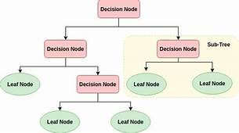
.
DECISION TREE
Decision Tree is a supervised learning method used in data mining for classification and regression methods. It is a tree that helps us in decision-making purposes. The decision tree creates classification or regression models as a tree structure. It separates a data set into smaller subsets, and at the same time, the decision tree is steadily developed. The final tree is a tree with the decision nodes and leaf nodes. A decision node has at least two branches. The leaf nodes show a classification or decision. We can't accomplish more split on leaf nodes-The uppermost decision node in a tree that relates to the best predictor called the root node. Decision trees can deal with both categorical and numerical data.
Key factors:
Entropy
Information Gain

Slide 11
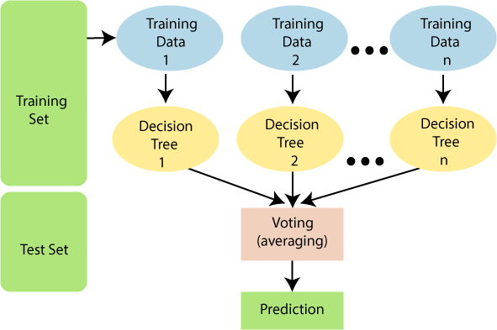
.
RANDOM FOREST
Random Forest is a popular machine learning algorithm that belongs to the supervised learning technique. It can be used for both Classification and Regression problems in ML. It is based on the concept of ensemble learning, which is a process of combining multiple classifiers to solve a complex problem and to improve the performance of the model.
“Random Forest is a classifier that contains a number of decision trees on various subsets of the given dataset and takes the average to improve the predictive accuracy of the dataset”

Slide 12
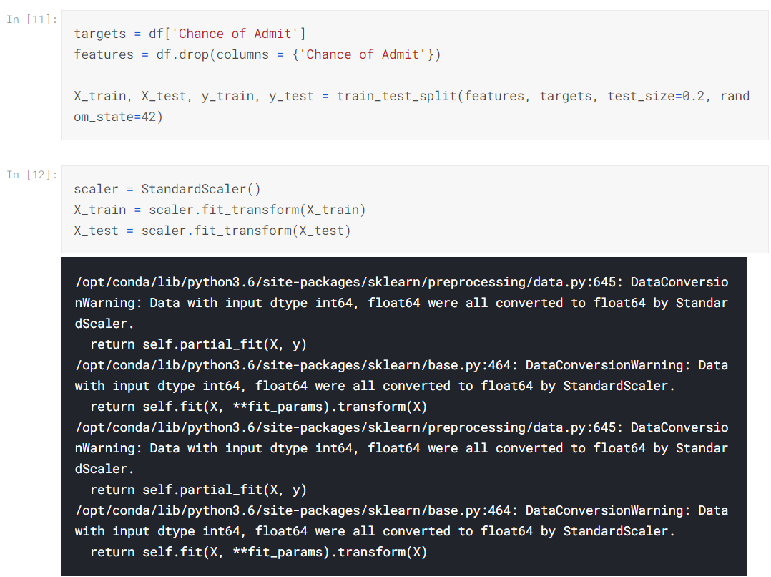
iMPLEMENTATION
Preparing Data for Machine Learning:
Now that we understand our dataset, it's time to implement machine learning methods to predict future applicant's chances of admission. First we have to prepare our data, by splitting it into training and testing data. We'll also scale our data, from 0 to 1, to receive more accurate predictions.

Slide 13
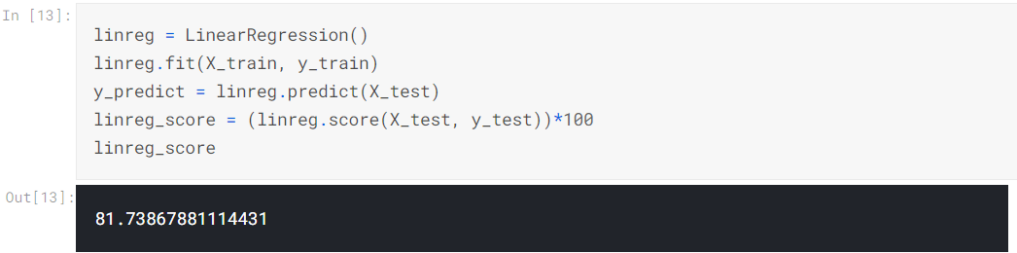
.
Linear Regression

Slide 14
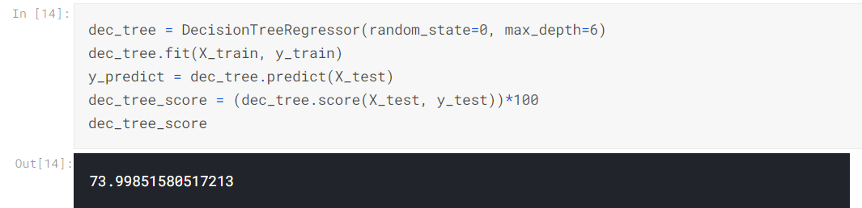
.
Random Forest

Slide 15
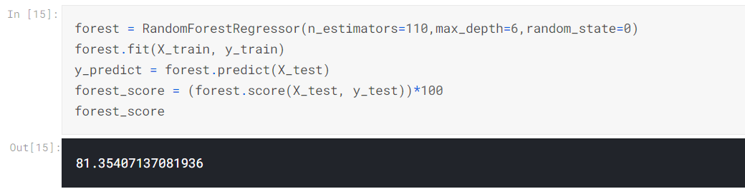
.
Decision Tree

Slide 16
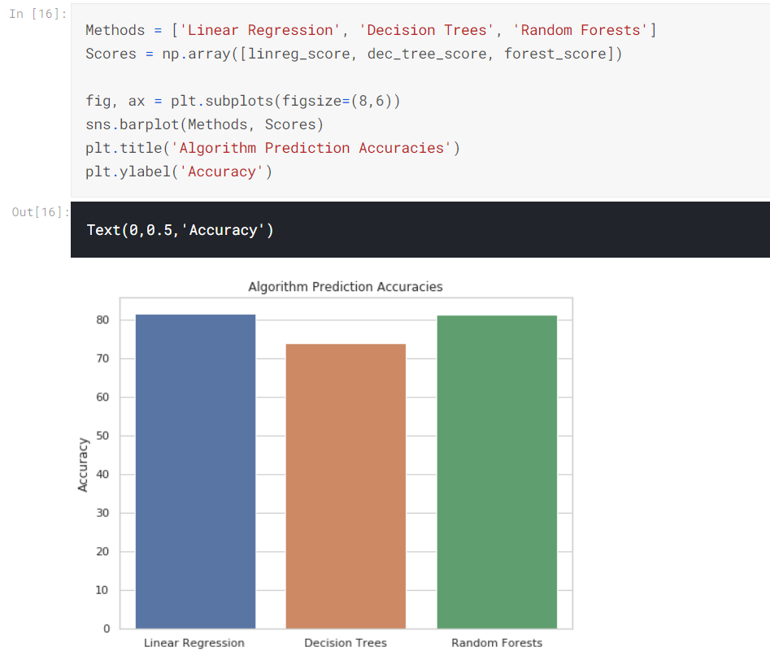
RESULT
Comparing Scores:
Let's put all the scores in a table and display their scores side-by-side.
Selecting the Best Algorithm:
Linear Regression - 81.74%
Random Forests - 81.35%
Decision Trees - 73.99%
It seems that Linear Regression is the most accurate of the 3 methods and will be used to predict the future applicant's chances of admission.

Slide 17
CONCLUSION
Table1:Base model evaluation
Prediction of the graduate admission of applicants, where the dataset was made of eight important features related to educational history, using and comparing supervised machine learning models. This research documented several model performances whether it was the coefficient of determination for regression or accuracy and AUC for classification. Ensemble techniques can be implemented to improve accuracy especially in terms of weak or unstable classifiers. To implement this predictor using the given dataset any model considered in this research will provide a minimum accuracy of 0.87 and R² score of 0.724; however, using an Ensemble technique are used to improve the accuracy score to an accuracy of 0.925. In general, all models can provide a good enough prediction given that the training data had double the number of accepted applicants to rejected applicants. This predictor proved to work competently; however, given the dataset, this predictor works only on the educational aspect of the applicant without taking into account personal data. This predictor has great potential in affecting the admission process worldwide. Therefore Linear regression has highest accuracy.
MODEL | Linear Regression
MAE | 0.04
MSE | 0.003
R2 Score | 0.84
ACCURACY | 0.81

Slide 18
REFERENCES
Chen, Y., Pan, C. C., Yang, G. K., & Bai, J. (2014, August). Intelligent decision system for accessing academic performance of candidates for early admission to university. In 2014 10th International Conference on Natural Computation (ICNC) (pp. 687-692). IEEE.
Hasan, M., Ahmed, S., Abdullah, D. M., & Rahman, M. S. (2016, May). Graduate school recommender system: Assisting admission seekers to apply for graduate studies in appropriate graduate schools. In 2016 5th International Conference on Informatics, Electronics and Vision (ICIEV) (pp. 502-507). IEEE.
Dietterich, T. G. (1997). Machine-learning research. AI magazine, 18(4),
Yazdipour, S., & Taherian, N. (2017, December). Data Driven Decision Support to Fund Graduate Studies in Abroad Universities. In 2017 International Conference on Machine Learning and Data Science (MLDS) (pp. 44-50). IEEE.

Slide 19
.
THANK YOU

